Slide 1
Laravel with MVC
Faisal Ahmed
Nabonita Das
Shishir Das
Selina Akter Shila
Sanjib Barma Shuvo
Souraiya Rahman

Slide 2
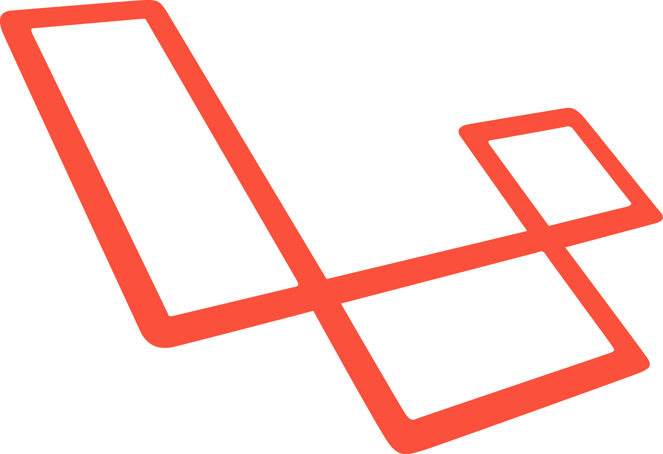
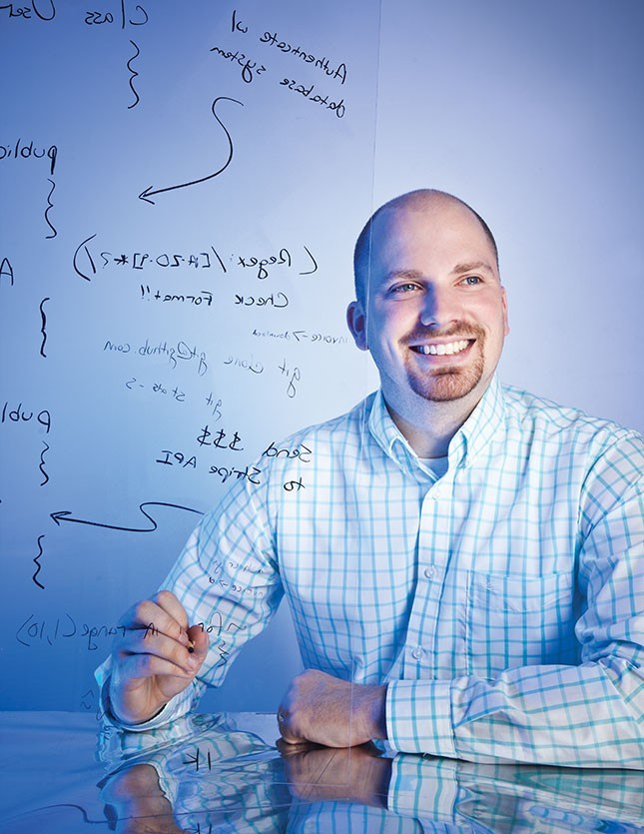
What is Laravel?
Free Open-Source Web Framework of PHP.
With expressive, elegant syntax.
Follows the MVC architectural pattern.
Taylor Otwell known as the creator of Laravel.

Slide 3
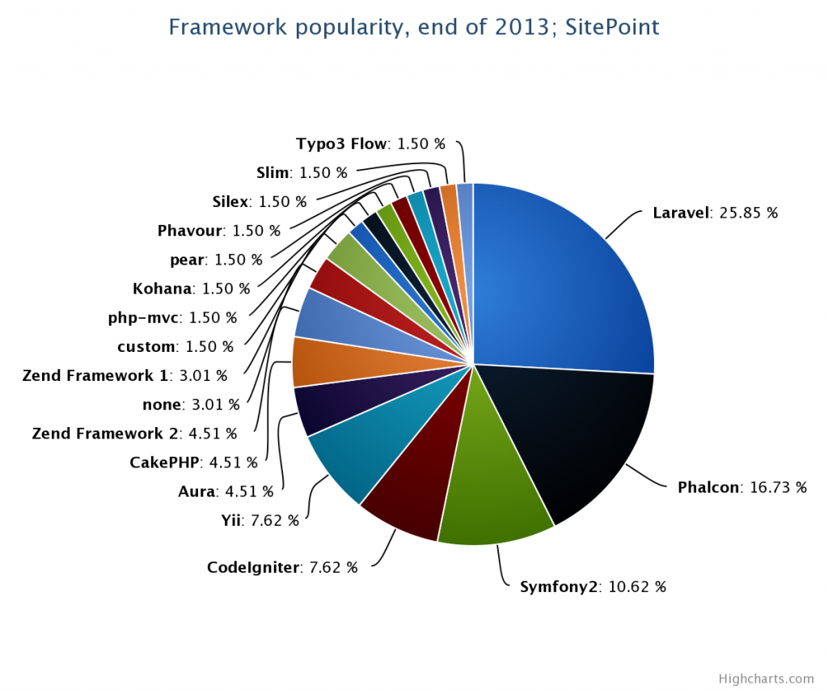
Why Laravel?
Expressive, beautiful syntax.
value elegance, simplicity & readability? you'll fit right in. Laravel is designed for people just like Us.
Modern toolkit. Pinch of magic
An amazing ORM, painless routing, powerful queue library and simle authentication give you the tools you need for Modern, maintainable PHP.

Slide 4
The basics of laravel
Routing
Building Layouts & Views
Adding tasks
Deleting tasks

Slide 5
Routing
Handles the HTTP Requests.
GET,PUT,POST,PATCH,DELETE.
App/routes.php
Accepts closures or controller namespace.

Slide 6
Stub
Connect only one router.
Data packet through a single router and leave the network through this same router.
Special case of the transient network .
Only on directional from the router to the network.

Slide 7
View
The presentation layer of an application.
Can accept either vanilla PHP or Blade files.
View files are located under app/views directory.
Can accept array arguments.

Slide 8
Layout
Some layouts are:
Blade templating engine use for layout.
Create a few site page
Page | Layout
Home | Full width
Projects | sidebar
About | Sidebar
Contact | full width

Slide 9
Child View
Method of container view controller.
This method tells UIkit that you container view controller is now managing the view of the child view controller.
Add the child’s root view to your container’s view hierarchy.
Add any constraints for managing the size and position of the child’s root view.
Call the didMoveToParentViewController: method to give the child view controller a chance to response to the change in the view ownership.

Slide 10
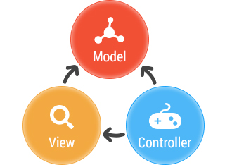
What is MVC?
The Model-View-Controller (MVC) is an architectural pattern that separates an application into three main logical components

Slide 11
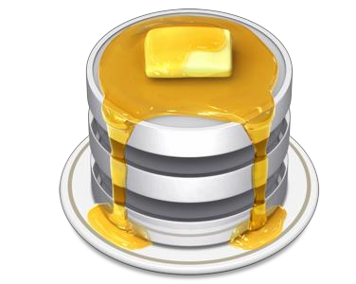
Model
`
The model is responsible for managing the data of the application.
It is also called domain layer.

Slide 12
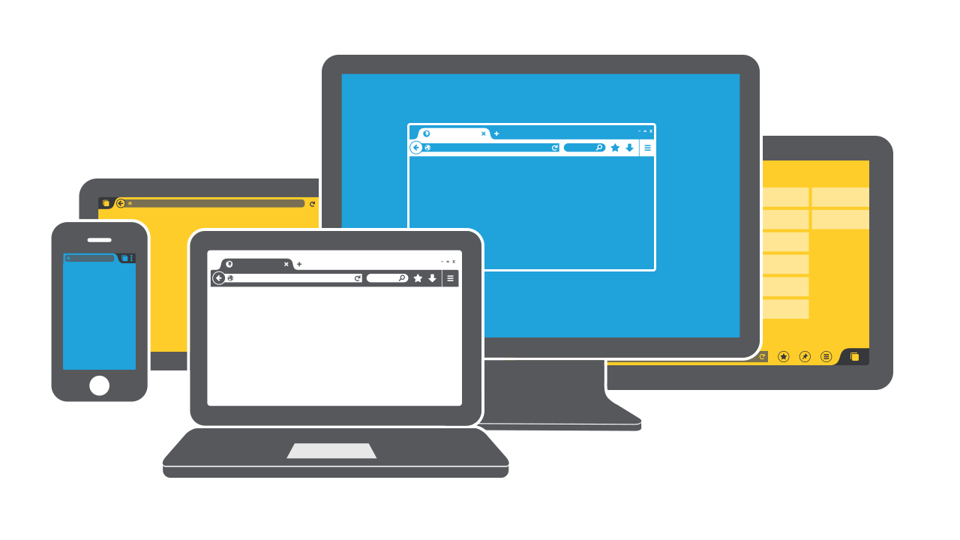
View
The view displays the data (the database record)
It presents data in a particular format like JSP, ASP, PHP

Slide 13
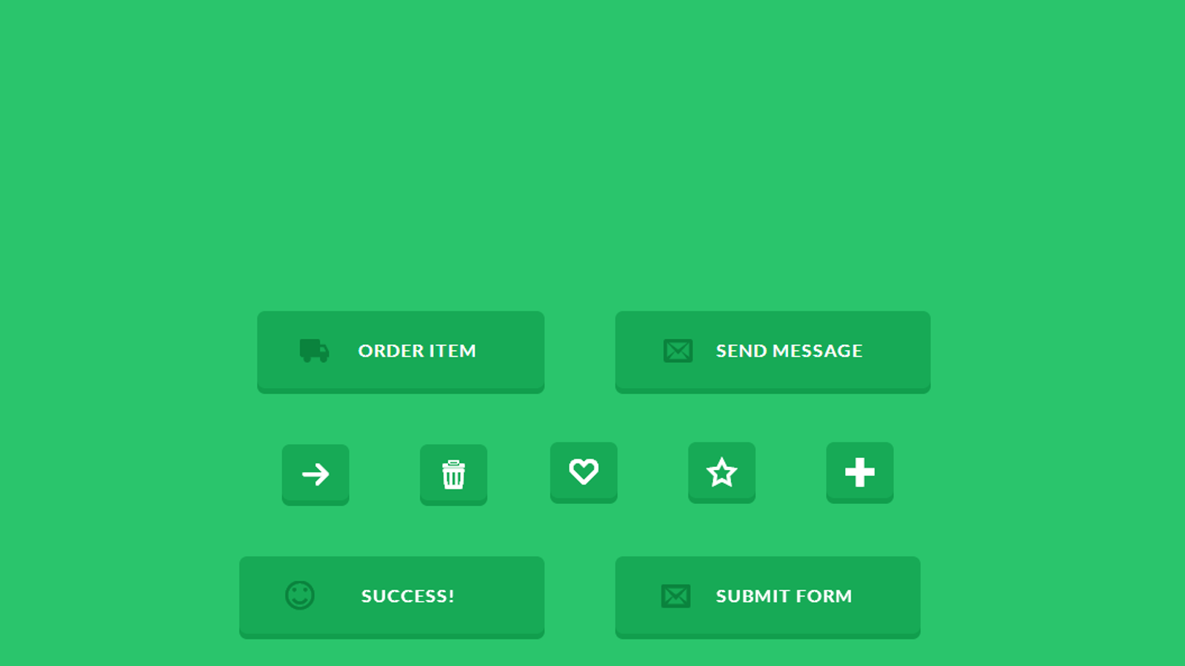
Controller
The Controller is the part of the application that handles user interaction.
Typically read data from a view, control user input, and send input data to the model

Slide 14
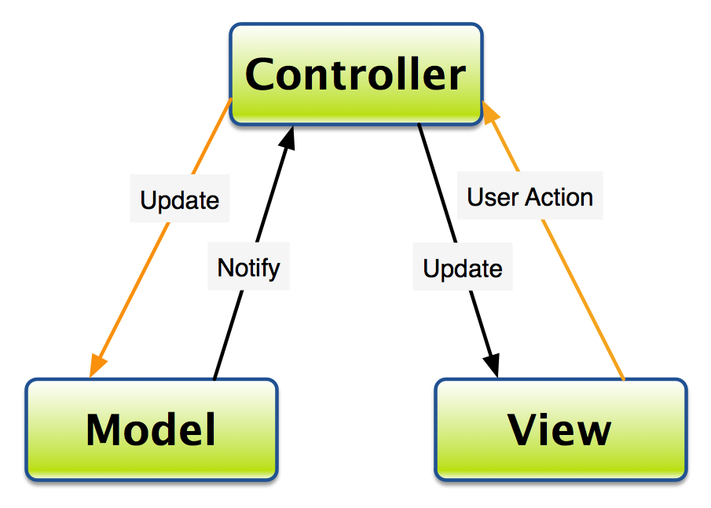
Work flow in MVC

Slide 15
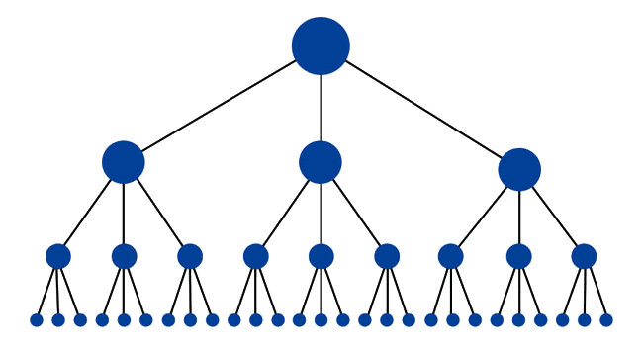
Dependency Hierarchy
There is usually a kind of hierarchy in the MVC pattern.
The view can display something that is based on what the model has done.

Slide 16
Some MVC Frameworks
Django
Rails(Ruby)
Zend Framework
CodeIgniter
CakePHP

Slide 17
Benefit in project
Faster development process
Ability to provide multiple views
Support for asynchronous technique
Modification does not affect the entire model
MVC model returns the data without formatting
SEO friendly Development platform

Slide 18
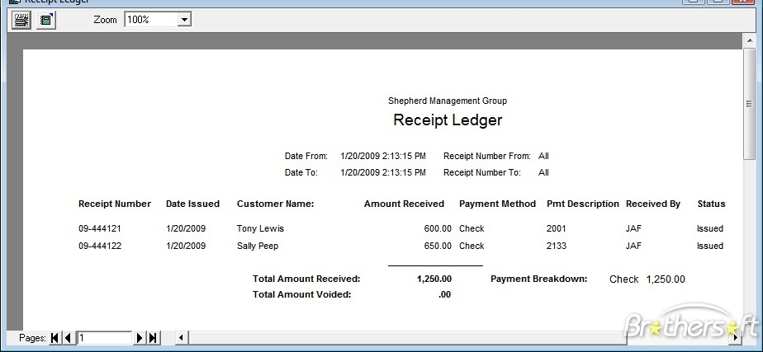
project E-Receipt and their user
send receipt via e-mail instead of paper receipt
service clients:
Govt . body
banks , stock exchange
super shop
restaurant , hotels

Slide 19
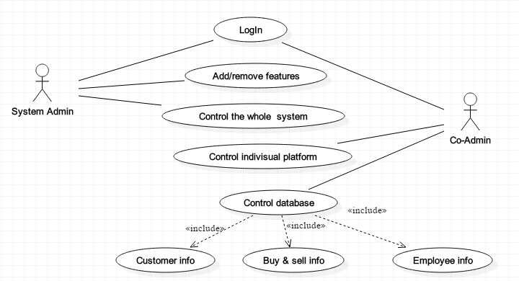
Use case of System Admin & Co-Admin

Slide 20
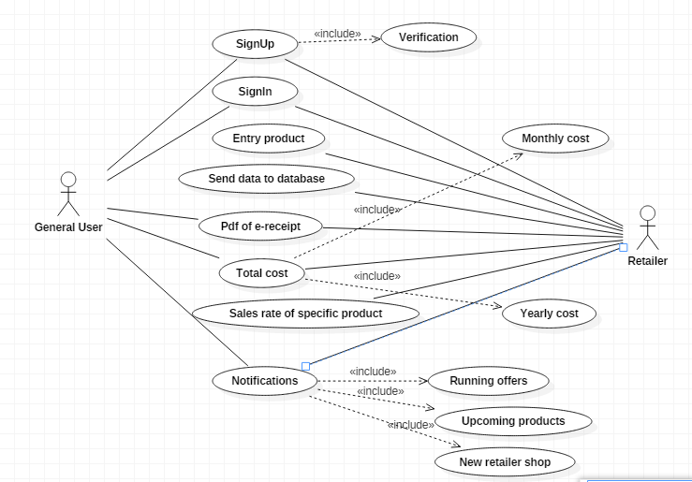
Use case of General user and Retailer

Slide 21
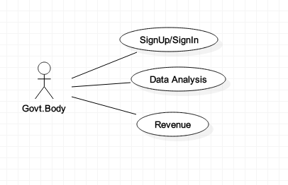
Use case of Govt.Body

Slide 22
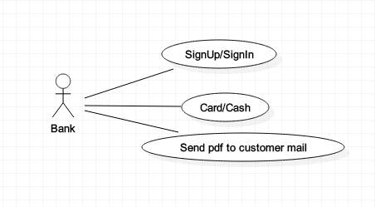
Use case of Bank

Slide 23
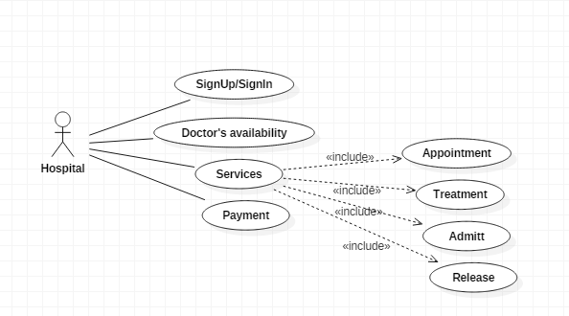
Use case of Hospital

Slide 24
Thank You!

